Slide 1
CMSC202
Computer Science II for Majors
Lecture 03 –
Arrays and Functions
Dr. Katherine Gibson
Based on slides by Chris Marron at UMBC

Slide 2
Last Class We Covered
C++ Primer
  Arithmetic expressions
  Operators
  Type casting
  Input / Output
  C-Strings
  Control Structures

Slide 3
Any Questions from Last Time?

Slide 4
Today’s Objectives
To understand how functions work in C++
  Prototype
  Definition
  Call
To cover the basics of arrays
  Declaration and initialization
  Multi-dimensional arrays
To examine how arrays and functions interact

Slide 5
Functions

Slide 6
“Parts” of Using Functions
Function Prototype (Declaration)
  Information for compiler
  To properly interpret calls
Function Definition
  Actual implementation (i.e., code) for function
Function Call
  How function is actually used by program
  Transfers control to the function

Slide 7
Function Prototype
Gives compiler information about the function
  How to interpret calls to the function
  <return type> <fxn name> (<parameters>);
  int squareNumber (int n);
  Must have the parameter’s data types
Placed before any calls
  In declaration space of main()
  Or above main() for global access

Slide 8
Function Definition
Implementation of the function
  Just like implementing the main() function
  int squareNumber (int n) {
  int answer = n * n;
  return answer;
  }
Function definition must match prototype

Slide 9
Function Definition Placement
Placed after the function main()
  NOT inside the function main()!
All functions are equal
  No function is contained inside another
Function name, parameter type, and return type all must match the prototype’s
return statement sends data back to the caller

Slide 10
Function Call
Very similar to how it’s done in Python
  int tenSquared = squareNum(10);
squareNum() returns an integer
  Assigned to the variable tenSquared
Arguments: the “literal” 10
  Could also have passed a variable
  Must be of type int – why?

Slide 11
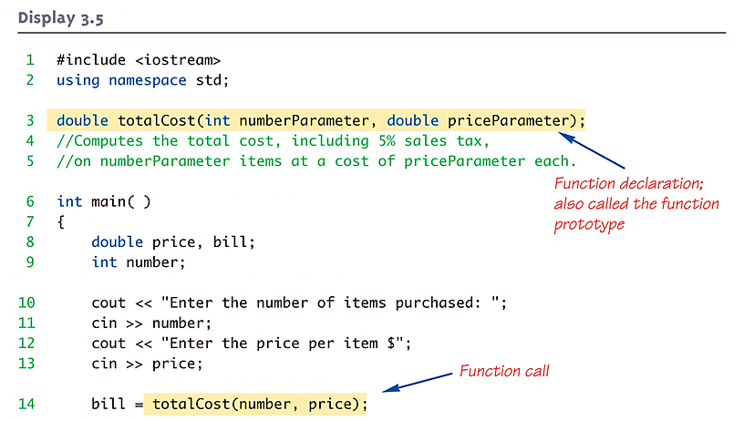
Function Example (part 1)

Slide 12
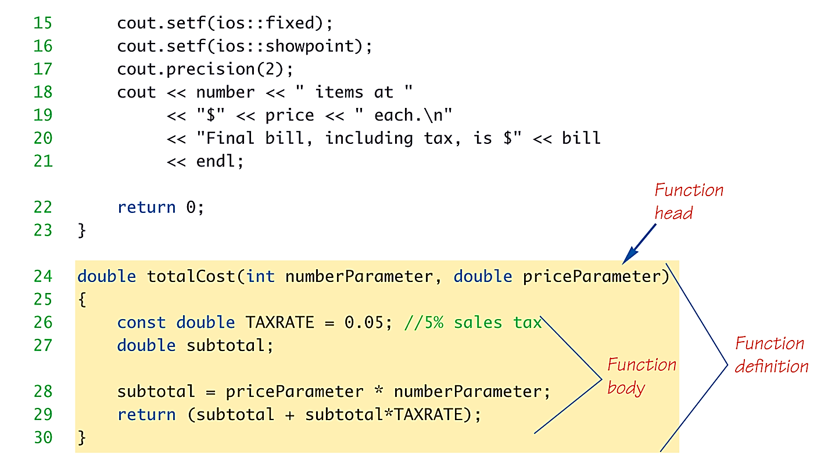
Function Example (part 2)

Slide 13
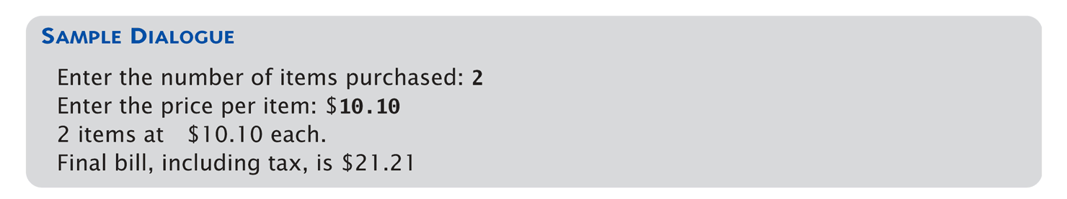
Function Example (usage)
Notice that the formatting changes
made to cout are persistent
They applied to both $10.10 and $21.21

Slide 14
Parameters vs Arguments
Often used interchangeably
  Technically, parameter is formal variable name; argument is actual value or variable
“Formal” parameters/arguments
  In the function prototype
  In the function definition
“Actual” parameters/arguments
  In the function call

Slide 15
Returning “void”
“void” functions are for when we don’t need to get a value back from the function
  Used for functions that only have side effects
  (e.g., printing out information)
Returning “void” means no value is returned
Declaration is similar to “regular” functions
  void printResults(double cost, double tax);
  Nothing is returned

Slide 16
“return” Statements
Transfers control back to the calling function
“return” statement optional for void functions
All other returns types must have a return statement in the function
  An error results otherwise
Typically the last statement in the definition
  Why?

Slide 17
Pre- and Post-Conditions
For this class, you’ll need to include function headers in your code (coding standards)
  Must contain name, pre-, and post-conditions
Conditions include assumptions about program state, not just the input and output
  // Function name: showInterest
  // Pre-condition: balance is nonnegative account
  // balance; rate is interest rate as percentage
  // Post-condition: amount of interest on given
  // balance, at given rate
  void showInterest(double balance, double rate);

Slide 18
Library Functions
C++ has libraries full of useful functions!
Must "#include" appropriate library
  e.g.,
  <cmath>, <cstdlib> (Original "C" libraries)
  <iostream> (for cout, cin)
Library functions are used in the same way as programmer-created functions

Slide 19
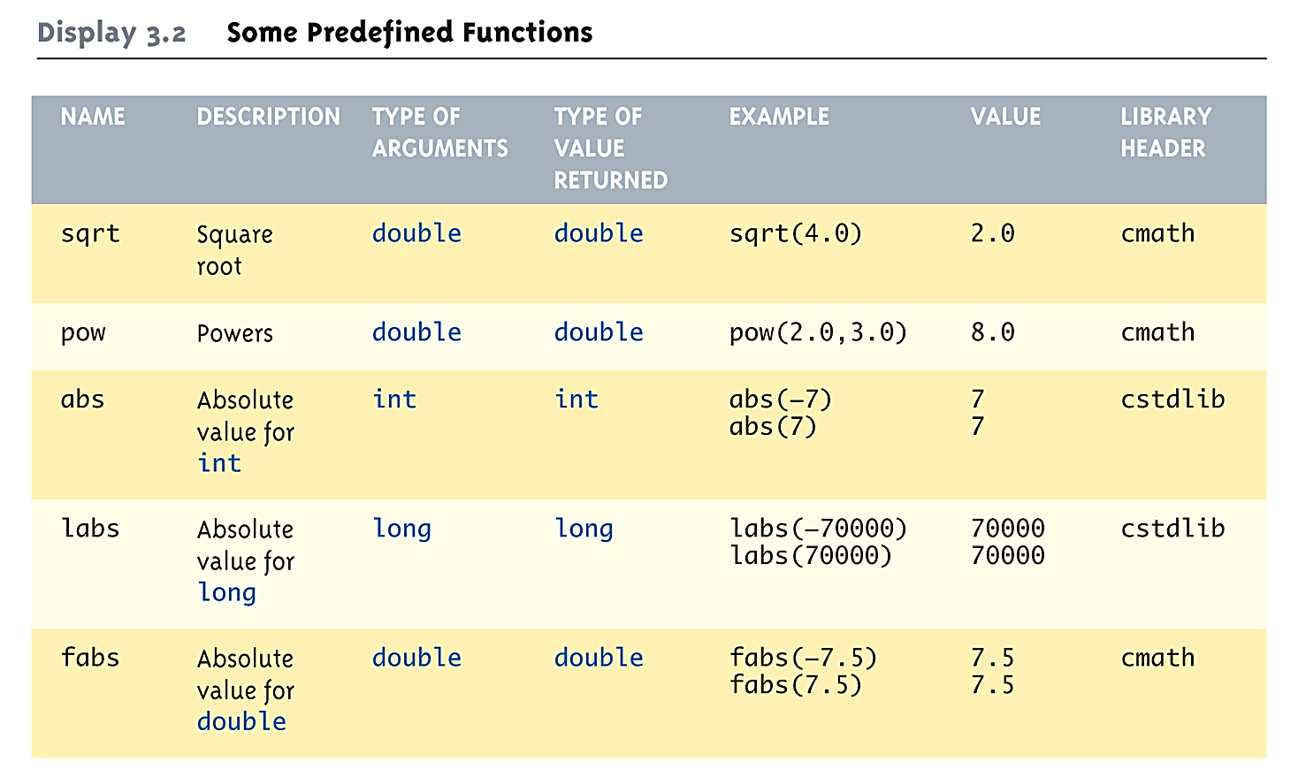
Useful Library Functions (part 1)

Slide 20
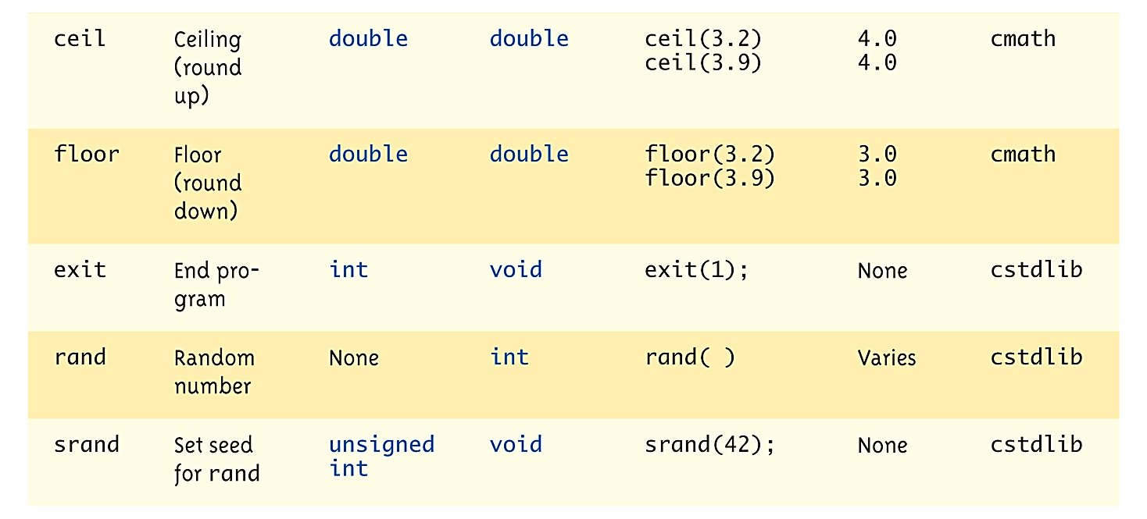
Useful Library Functions (part 2)

Slide 21
The main() Function
main() is also a function – a “special” one!
One (and only one) function called
main() can exist in a program
The operating system calls main()
  Not the programmer!
Should return an integer (0 is traditional)
  return 0;

Slide 22
Why Use Functions?
Allows you to build “blocks” of programs
  Divide and conquer large problems
Increases readability and reusability
  Put in a separate file from main() for easy sharing
Quick note:
  Functions in C++ can only return one thing!!!
  (For now)

Slide 23
Arrays

Slide 24
Arrays
An array is a collection of related data items
  An array can be of any data type you choose
  They all have the same data type
Arrays are static – their size does not change
  They are declared contiguously in memory
  In other words, an array’s data is stored in
  one big block, together

Slide 25
Declaring Arrays
Declaration:
  <type> <name> [size];
  float xArray [10];
  This array now has room to hold 10 floats
Indexing starts at 0:
  xArray[9]; /* end of the array */

Slide 26
Limitations of an Array
An array does not know how large it is
  No size() function
  No bounds checking – you must be careful!
Arrays are static
  Their size must be known at compile time
  Their size cannot be changed once set
  You cannot use user input for array size
    “How many numbers would you like to store?”

Slide 27
Array Initialization
A declaration does not initialize the data stored in the memory locations
  They contain “garbage” data
    Whatever is left from the last time it was used
An array can be initialized at declare time:
  int numbers[5] = { 5, 2, 6, 9, 3 };
5 | 2 | 6 | 9 | 3

Slide 28
Auto-Initialization
If there are fewer values than the given size:
  Fills values starting at the beginning
  Remainder is filled with that data type’s “zero”
If no array size is given:
  Array is created only as big as is needed
  based on the number of initialization values
  int yArray[] = {5, 12, 11};
  Allocates array yArray to hold 3 integers

Slide 29
C-String Initialization
C-Strings are arrays of characters
They can be initialized in the normal way
  char name[5] = {'J', 'o', 'h', 'n', 0 };
Or with a string constant:
  char name[5] = "John";
Different quotes have different purposes!!!
  Double quotes are for strings
  Single quotes are for chars (characters)

Slide 30
Accessing Array Elements
Use square brackets to access a single element
  cout << "The third element is "
  << numbers[2] << endl;
This gives the output:
  The third element is 6
0 | 1 | 2 | 3 | 4
5 | 2 | 6 | 9 | 3
numbers =

Slide 31
Accessing Array Elements
C++ also accepts any expression as a “subscript”
  But it must evaluate to an integer
  numbers[(start + end) / 2];
IMPORTANT!
C++ does not do bounds checking for simple arrays, so you must ensure you are staying within bounds

Slide 32
Constants as Array Size
You should always used a defined/named constant for your array size
  Do not use magic numbers!
  const int NUMBER_OF_STUDENTS = 5;
  int score[NUMBER_OF_STUDENTS];
Improves readability, versatility, and maintainability

Slide 33
Arrays and Functions

Slide 34
Arrays in Functions
As arguments to functions
  Indexed variables
    An individual element of an array can be passed
  Entire arrays
    All array elements can be passed as one entity
As return value from function
  Can be done, but we’ll cover it later

Slide 35
Passing Indexed Variables
Handled the same way as a “regular” variable
  Function declaration:
  void myFunction(double par1);
  Variables:
  double n, a[10];
  Valid function calls:
  myFunction(a[3]); // a[3] is double
  myFunction(n); // n is double

Slide 36
Passing Entire Arrays
Formal parameter can be an entire array
  Passed into the function by the array’s name
  Called an array parameter
Must send size of array as well
  Typically done as second parameter
  Simple integer-type formal parameter

Slide 37
Live Coding Exercise
fillUp.cpp
Arrays, initialization, and functions

Slide 38
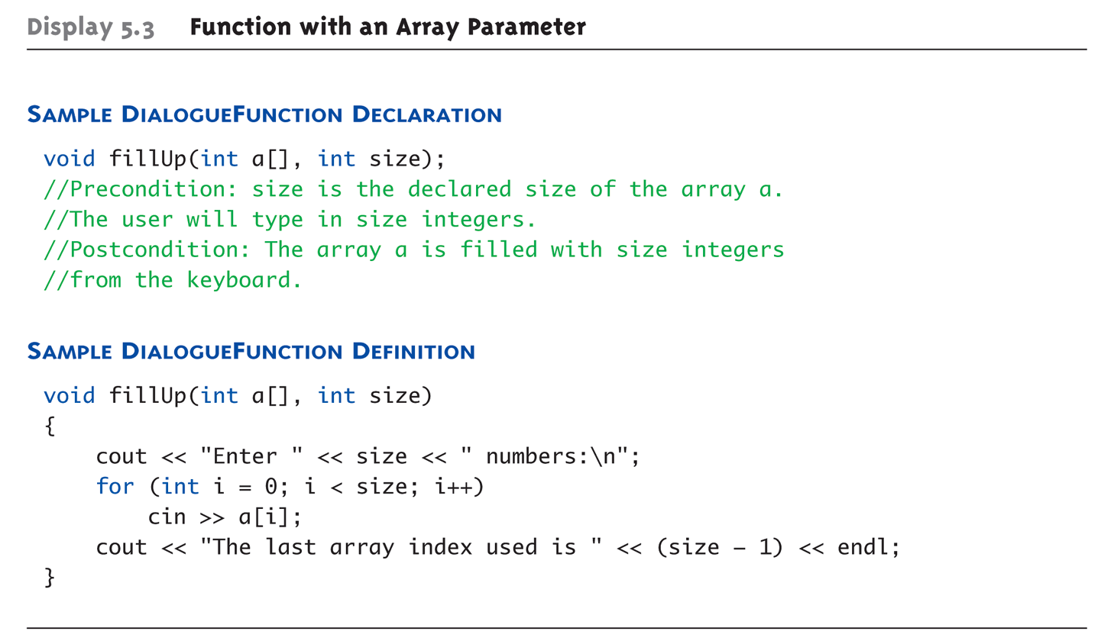
Array Parameter Example

Slide 39
Array as Argument Example
Using the function from the previous slide, consider this code, inside a main() function:
  int score[5], numberOfScores = 5;
  fillUp(score, numberOfScores);
entire array
integer value
Note the lack of [] brackets
in the array argument!

Slide 40
Array as Argument Explanation
How does this work? What’s being passed?
Think of an array as 3 components:
  Address of first indexed variable (arrName[0])
  Array base type
  Size of array
Only the first piece is passed!
  Just the beginning address of the array
  We’ll discuss this in detail later

Slide 41
Array Parameters
Array size must be sent separately
  But this actually increases functionality!
Same function can be used on any size array!
  int score[5], time[10];
  fillUp(score, 5);
  fillUp(time, 10);

Slide 42
Multidimensional Arrays
Arrays with more than one index
  char page[30][100];
  Two indices: an "array of arrays"
  Visualize as:
  page[0][0], page[0][1], ..., page[0][99]
  page[1][0], page[1][1], ..., page[1][99]
  ...
  page[29][0], page[29][1], ..., page[29][99]
C++ allows any number of indexes
  Typically no more than two or three

Slide 43
Multidimensional Array Parameters
Similar to one-dimensional array
  1st dimension size not given
    Provided as second parameter of function
  2nd dimension size is given
  void DisplayPage(char page[][100], int numRows) {
  for ( int i = 0; i < numRows; i++ ) {
  for ( int j = 0; j < 100; j++ ) {
  cout << page[i][j];
  }
  cout << endl;
  }
  }

Slide 44
Review: Array Limitations
Simple arrays have limitations
  Array out-of-bounds access
  No resizing
  Hard to get current size
  Not initialized
  Mostly due to efficiency and backwards-compatibility, which are high priorities in C/C++
Later, we will learn about the vector class, which addresses many of these issues

Slide 45
Announcements
The course policy agreement is due back in class by Tuesday, February 9th
  Worth 1% of your grade
  (Final is now worth 19%)
The Blackboard site is now available
  Course schedule is now available
Next time: Pointers and References

